Slide 1
July 31st, 2024

Slide 2
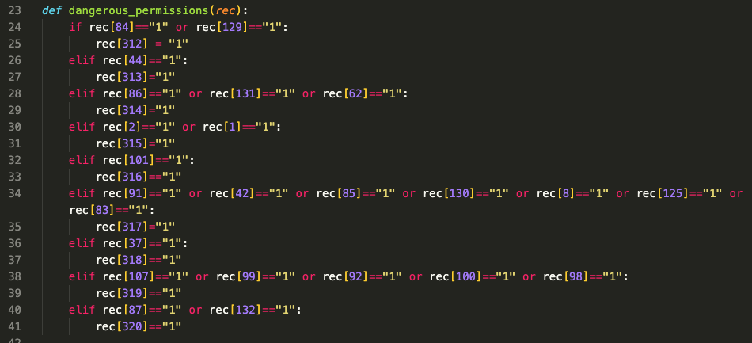
Two bugs found in readPermissions.py

Slide 3
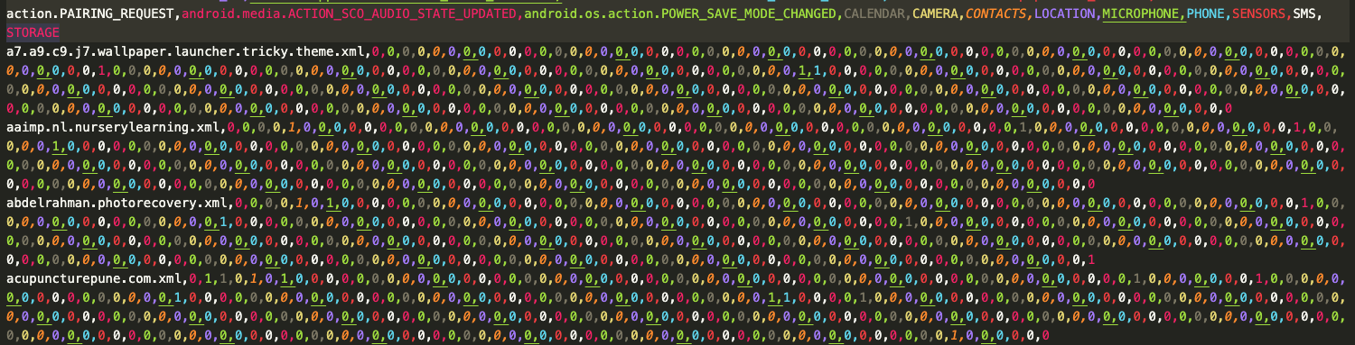
Now able to get proper permission/action .csvs

Slide 4
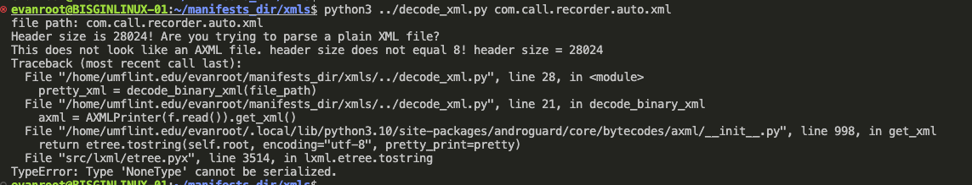
Now trying to run on all manifest files
Decoding files in xmls1to22 directory is not working as it did on .xmls from eapks directories
*Files in eapks are encoded, in xmls1to22 they are not

